Slide 1


Slide 2


Slide 3


Slide 4
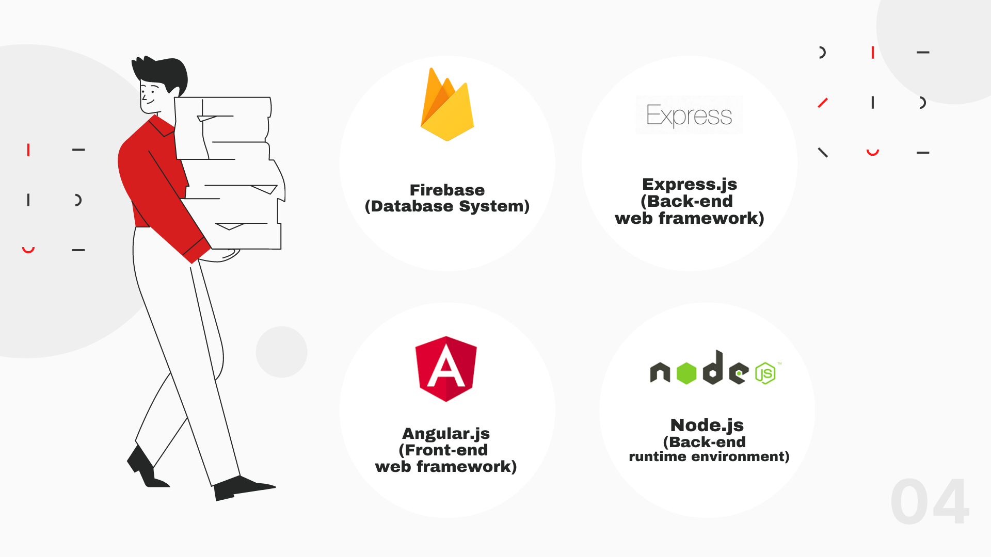

Slide 5


Slide 6







Web Application Architecture
Client side
HTTP Request
Request
API
Angular.js
Bootstrap / CSS
Chart.js
Response
Express.js / Node.js
Response
Web Server
Browser
HTML
Front-end
Firebase Storage
Firestore
File Storage
Database
Back-end
Platform as a Service (PaaS)

Slide 7




Slide 8

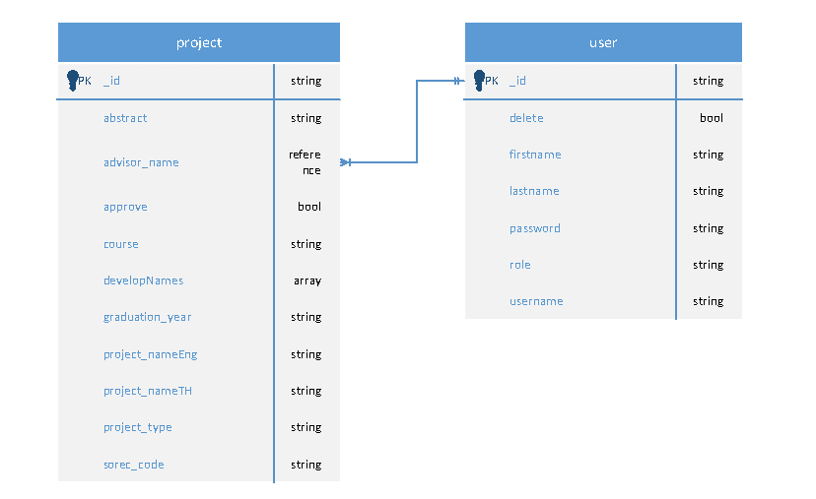

Slide 9


